Slide 1
LITERATURE REVIEW
Fariza Khalid

Slide 2
What is a literature review?
A literature review is a select analysis of existing research which is relevant to your topic, showing how it relates to your investigation. It explains and justifies how your investigation may help answer some of the questions or gaps in this area of research.

Slide 3
What is a literature review?
The ability to review, and to report on relevant literature is a key academic skill.
A literature review:
situates your research focus within the context of the wider academic community in your field;
reports your critical review of the relevant literature; and
identifies a gap within that literature that your research will attempt to address.

Slide 4
Why write a literature review?
New discoveries don't materialise out of nowhere; they build upon the findings of previous experiments and investigations.
A literature review shows how the investigation you are conducting fits with what has gone before and puts it into context.

Slide 5
Why write a literature review?
Shows how your investigation relates to previous research
Reveals the contribution that your investigation makes to this field (fills a gap, or builds on existing research, for instance)
Provides evidence that may help explain your findings later

Slide 6
Why write a literature review?
To have up-to-date awareness of the relevant work of others
To make sure the relevance of your research question
To ‘address a gap’
To understand and critically analyse the background research
To select and source the information that is necessary to develop a context for your research

Slide 7
Phases of doing LR
Prior
During
At the end

Slide 8
An early review
to establish the context and rationale for your study and to confirm your choice of research focus/question;

Slide 9
During
to make sure that you keep in touch with current, relevant research in your field, which is published during the period of your research;

Slide 10
At the end
you need to relate your findings to the findings of others, and to identify their implications for theory, practice, and research. This can involve further review with perhaps a slightly different focus from that of your initial review.

Slide 11
How to start?

Slide 12
What research has already been done on this topic?
What are the sub-areas of the topic you need to explore?
What other research (perhaps not directly on the topic) might be relevant to your investigation?
How do these sub-topics and other research overlap with your investigation?

Slide 13
Note down all your initial thoughts on the topic.
You map e.g., spidergram or list to help you identify the areas you want to investigate further.
It is important to do this before you start reading so that you don't waste time on unfocussed and irrelevant reading

Slide 14
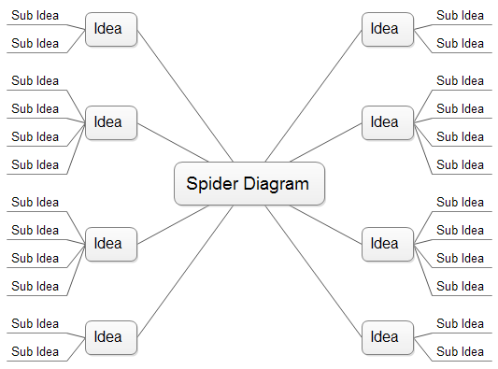
Spidergram

Slide 15
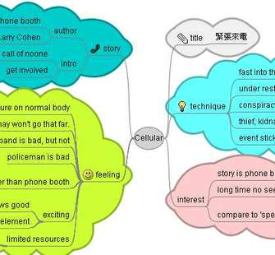
Freemind

Slide 16
A ‘good’ literature review….. ….. is a synthesis of available research ….. is a critical evaluation ….. has appropriate breadth and depth ….. has clarity and conciseness ….. uses rigorous and consistent methods | A ‘poor’ literature review is….. …..an annotated bibliography ….. confined to description ….. narrow and shallow ….. confusing and longwinded ….. constructed in an arbitrary way

Slide 17
Ways of finding relevant material
Electronic sources
References of references
Hand searching of journals

Slide 18
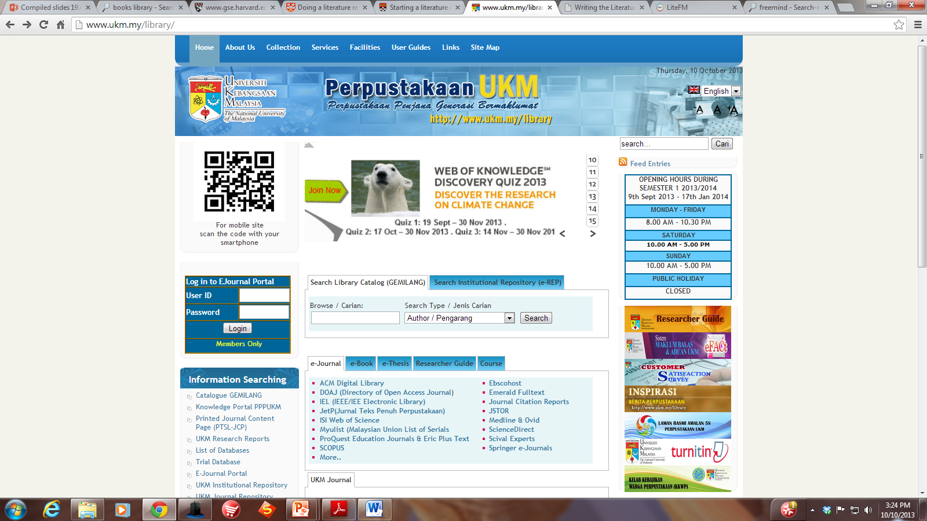

Slide 19
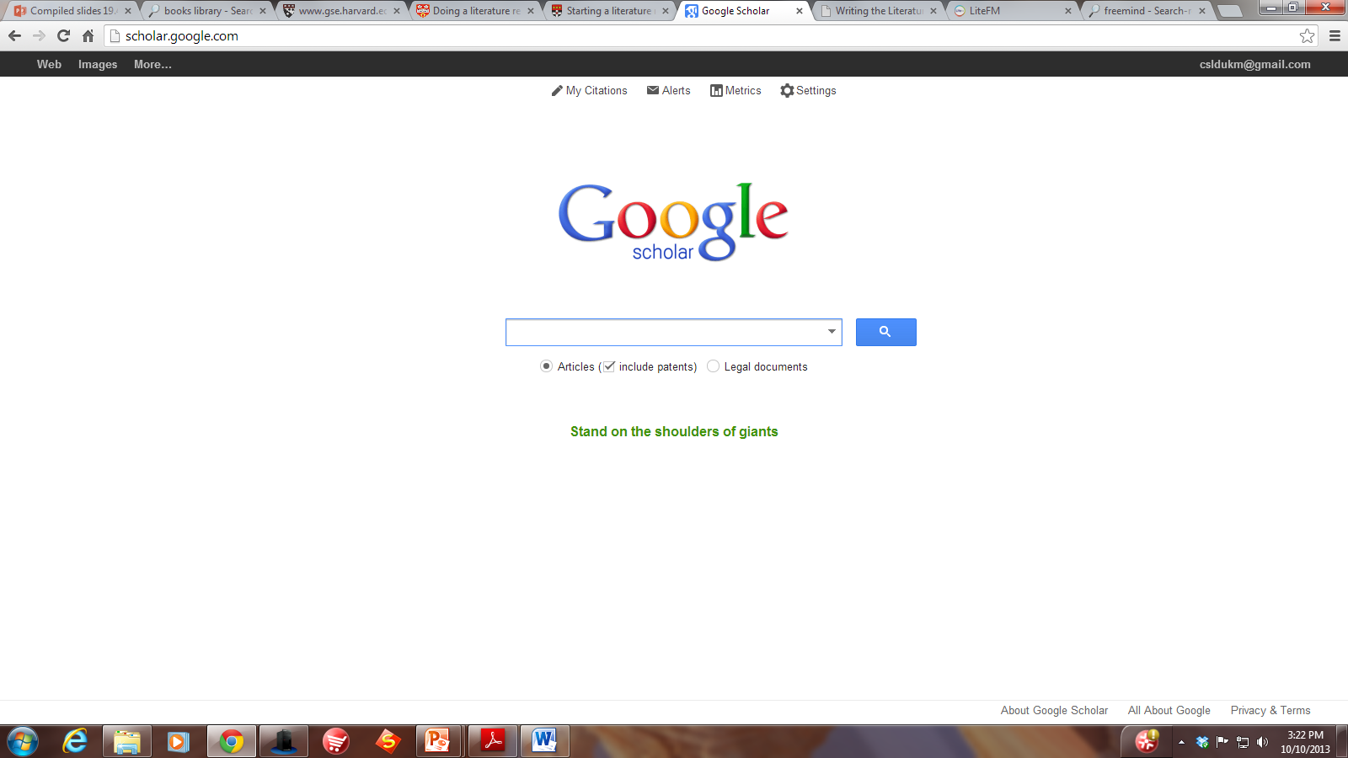

Slide 20
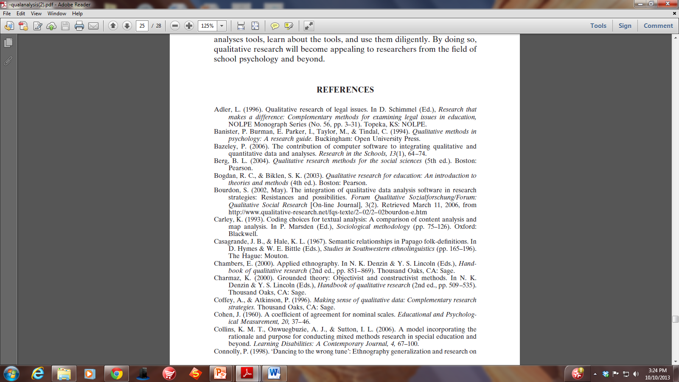

Slide 21
Plagiarism
Plagiarism is regarded as a serious offence by all Universities.
Plagiarism is the using of someone else’s words or ideas, and passing them off as your own.
[NOTE: It can happen accidentally, for example, if you are careless in your note-taking. This can mean that you get mixed up over what is an exact quote, and what you have written in your own words; or over what was an idea of your own that you jotted down, or an idea from some text.]

Slide 22
Tips to avoid plagiarism
Record short extracts of text verbatim i.e., using the EXACT WORDS of the author, rather than putting the idea into your own words at the point where you are still reading.
You will need to put inverted commas (‘xxx’) around the exact quote, and record the page number on which it appears.

Slide 23
This has the advantage that, when you come to use that example in your writing up, you can choose:
to use the exact quote in inverted commas, with the reference and page number; or
to describe it in your own words, and use the standard reference format, without the page number, to acknowledge that it was someone else’s idea.

Slide 24
Reminder
Rudestam and Newton (1992:49) remind us that the aim is to ‘Build an argument, not a library’.

Slide 25
Writing it up
It should be framed by your research questions.
It must relate to your study.
It must be clear to the reader where it is going: keep signposting along the way.
Wherever possible, use original source material rather than summaries or reviews by others.

Slide 26
Writing it up
Be in control, not totally deferent to or ‘tossed about by’ previous literature.
Be selective. Ask ‘why am I including this?’
It is probably best to treat it as a research project in its own right.
Engage in a dialogue with the literature, you are not just providing a summary.”

